Slide 1
Final Project
Huaikuan Li

Slide 2
Problem to be sloved
Is it possible to predict the scores of soccer game?

Slide 3
Data Description
All 760 matches data of Premier League 2019- 2020
Columns include:
Match Name
Match Date
Team
Score
Possession
Success Pass
Number of Pass
Number of Shots
Success Shots
Passing Accuracy
Shots Accuracy
etc.

Slide 4
Models
Stepwise
Neuralnet

Slide 5
Stepwise
 | RMSE
Linear Regression | 0.88426
Stepwise forward | 0.87851
Stepwise backward | 0.88598
Stepwise both | 0.87269

Slide 6
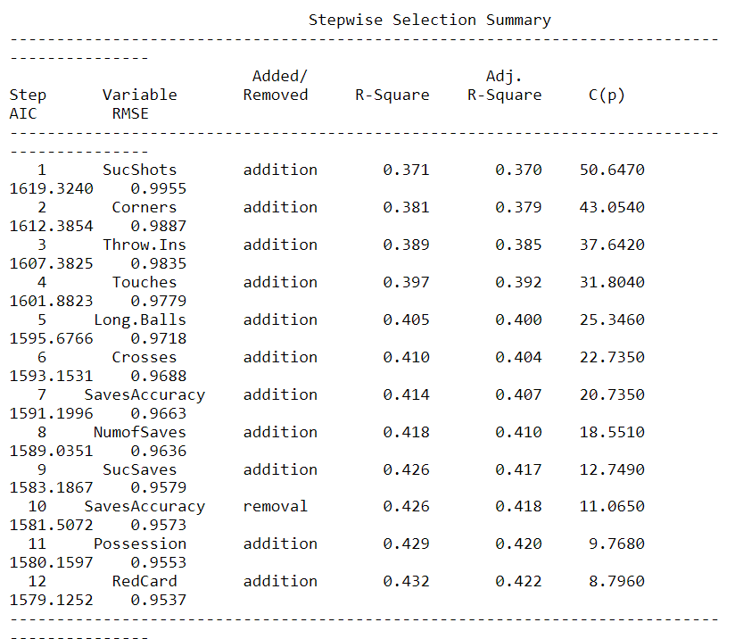
Stepwise

Slide 7
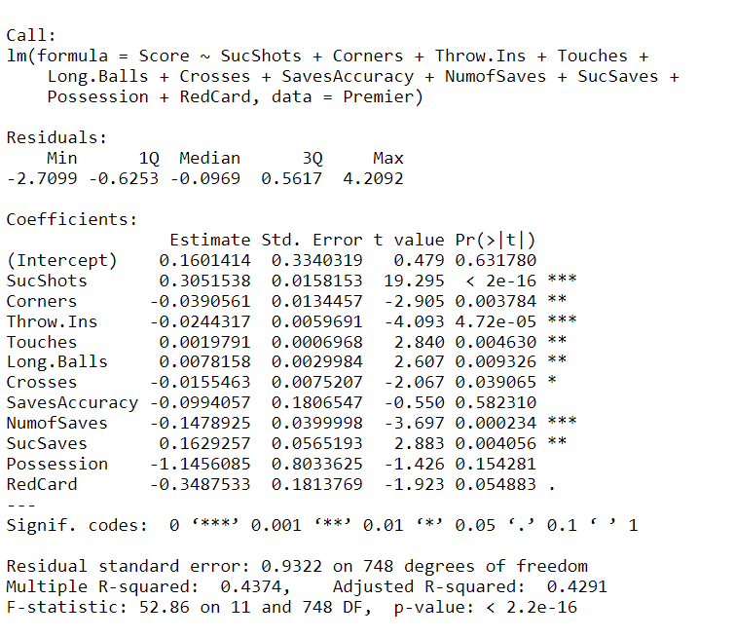
Stepwise
Regression Accuracy: 0.005291005

Slide 8
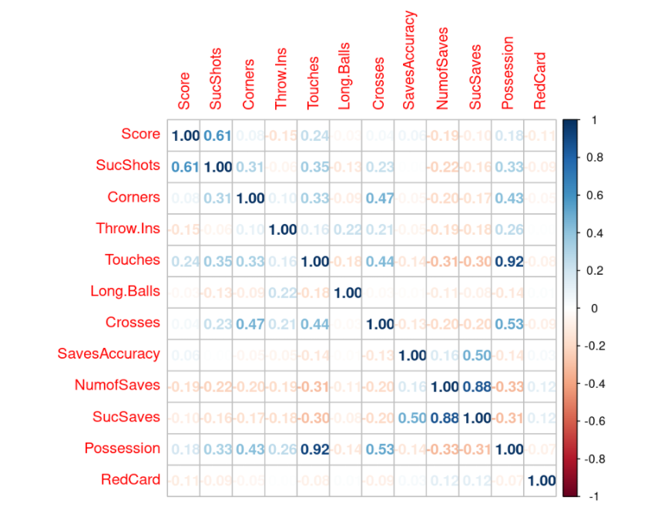
Stepwise

Slide 9
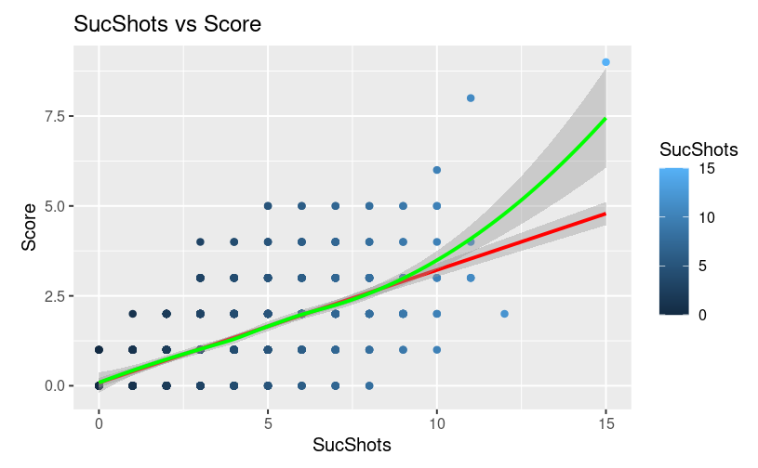
Stepwise

Slide 10
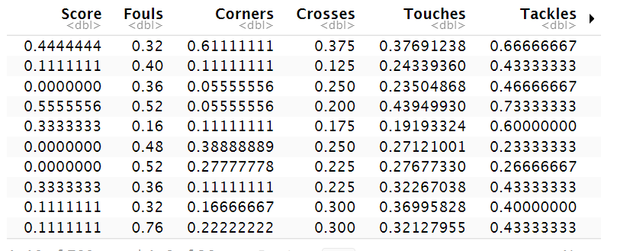
Neuralnet
Normalization

Slide 11
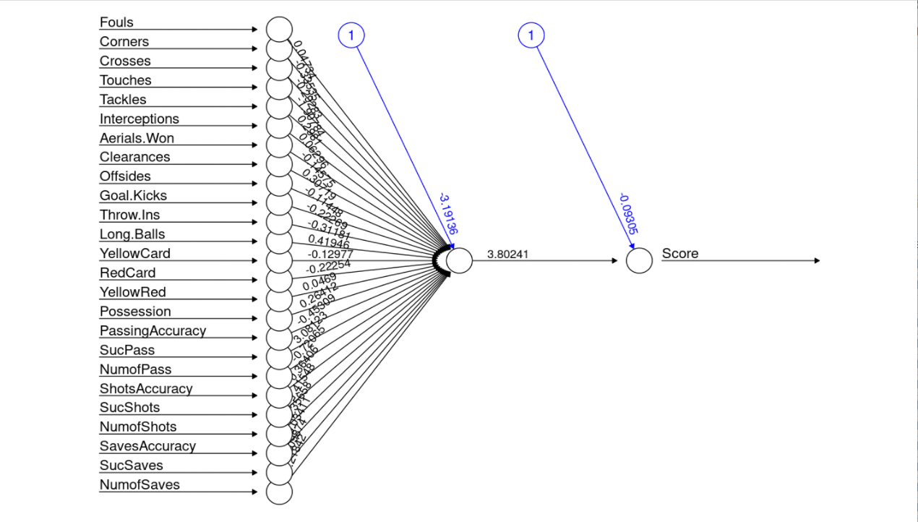

Slide 12
Compare predictions to the test dataset
Correlation:
0.6863

Slide 13
End

